Slide 1
Welcome To My Presentation
Joy Dhar
ID: 16201063

Slide 2
Online Food Order
Food at your doorstep

Slide 3
ABSTRACT
ONLINE FOOD ORDER is a website designed primarily for use in the food delivery industry. This system will allow hotels and restaurants to increase scope of business by reducing the labor cost involved.
My system will allow restaurants to quickly and easily manage an online menu which customers can browse and use to place orders with just a few clicks.

Slide 4
Contents
01
User Registration
User need to complete registration to order food
02
Food Menu
User can see all the food available in this system
03
Food Order
User can place order and see the orders
04
Admin
Admin can add food and monitor the food

Slide 5
Online Food Order Functions
Create an account.
Log in to the system.
Place order from Food menu

Slide 6
Online Food Order Systems
Web Ordering System
- provides the functionality for customers to place their order and supply necessary details.
Menu Management
- allows the restaurant to control what can be ordered by the customers.
Order Retrieval System
- This is a final logical component. Allows restaurant to keep track of all orders placed. This component takes care of order retrieving and displaying order information.

Slide 7
System Visualization
customer
customer
Web Ordering System
Database
Order Retrieval
Restaurant Employee
customer
Menu Management System
Admin

Slide 8
Technology Used
PHP
BOOTSTRAP
JAVASCRIPT
HTML & CSS

Slide 9
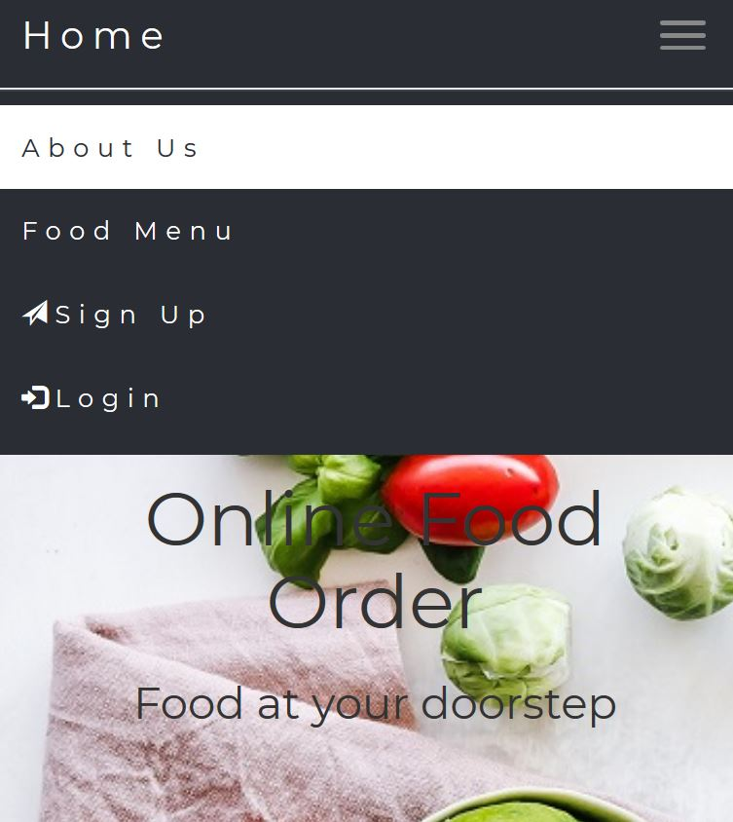
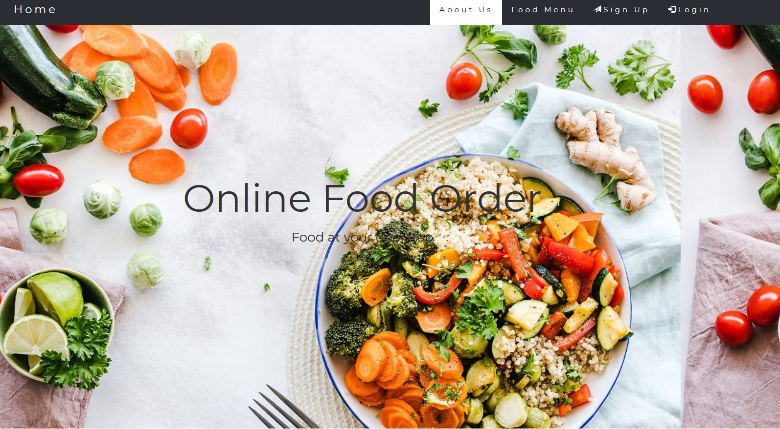
Responsive Website
Mobile View
Computer View

Slide 10
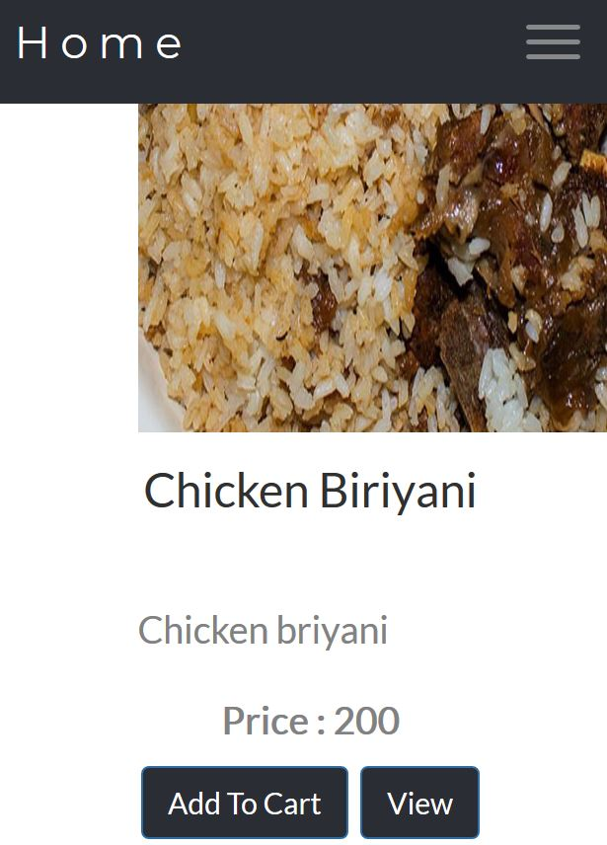
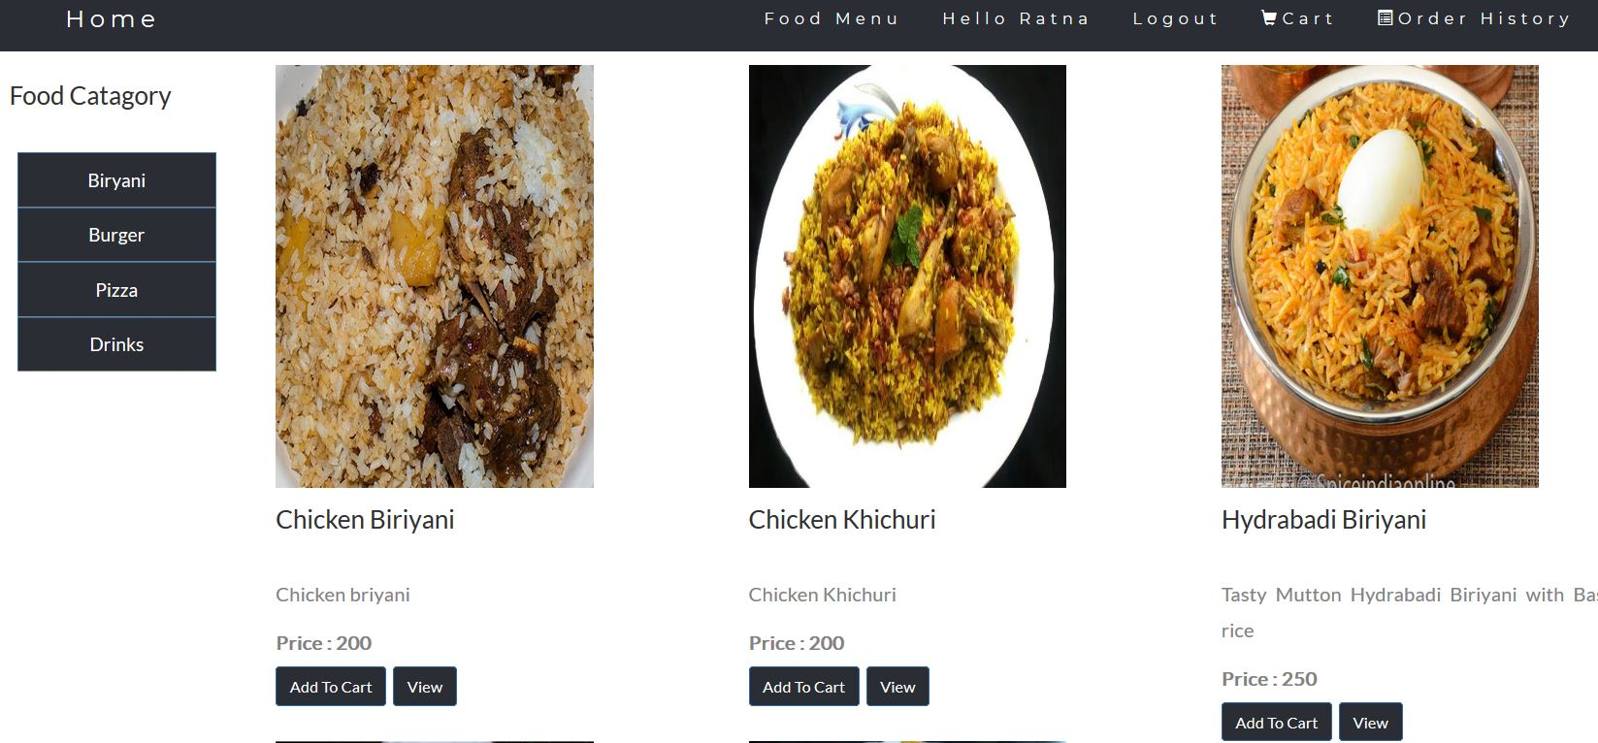
Responsive Website
Mobile View
Computer View

Slide 11
ADVANTAGES OF THE PROPOSED SYSTEM
Greater Efficiency
Minimum Time required
It is more user-friendly
Better Service

Slide 12
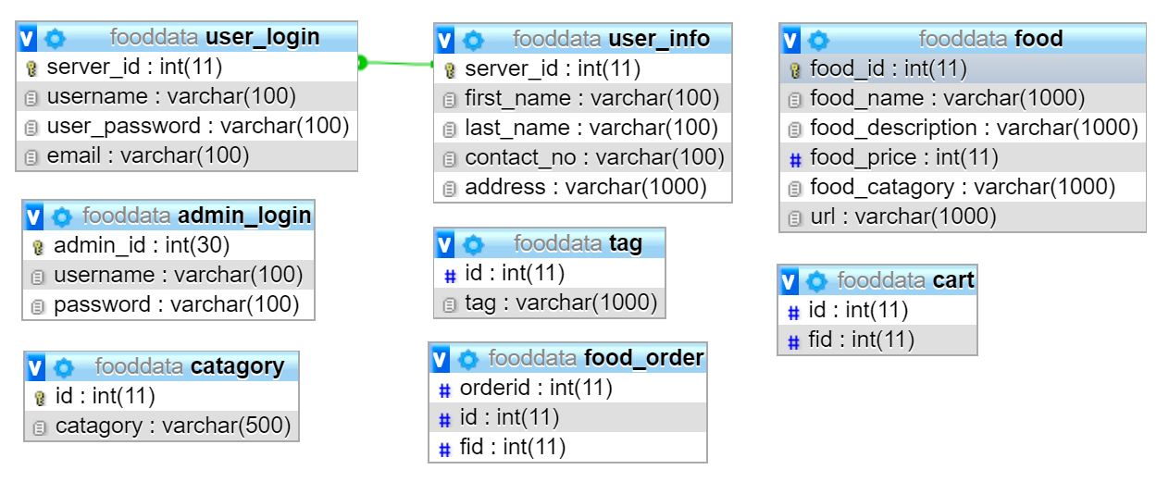
Database Design

Slide 13
ER DIAGRAM
admin_id
Last_name
Contact_no
username
server_id
First_name
username
address
password
password
email
admin_login
user_info
user_login
has
food_name
fid
cart
REGISTER
id
catagory
Belong to
Belong to
food_id
food
belong to
food_name
food_order
Order_id
Food_description
id
tag
food_price
food_catagory
fid
url
tag
fid

Slide 14
THANK YOU

